Slide 1
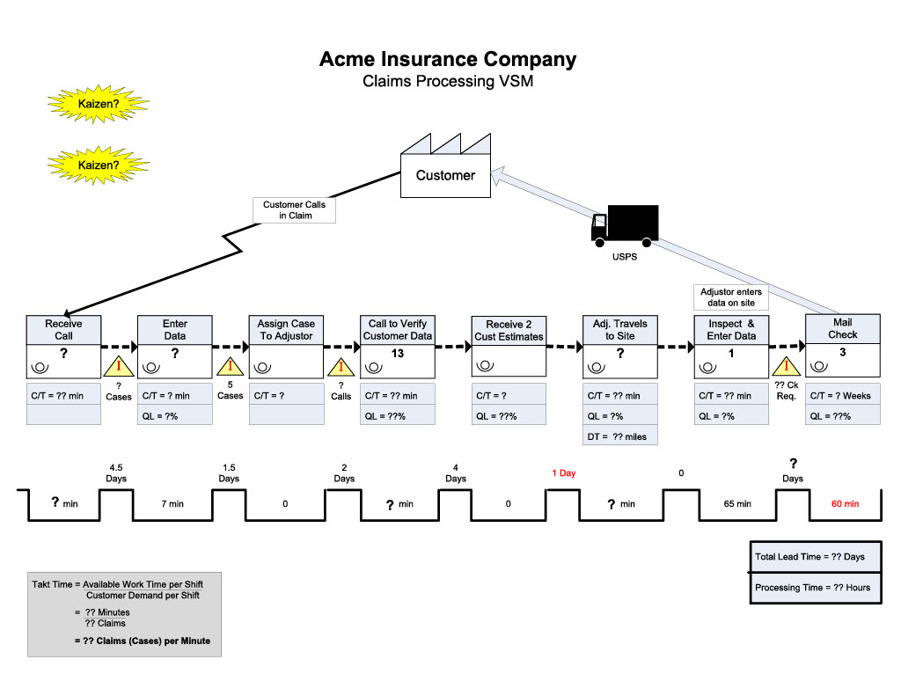
6
4
3
2
3
15
1.5 days
20
4 days
50

